Slide 1
Search Algorithms
Prepared by: Afaq Mansoor Khan
BSSE III- Group A
Session 2017-21
IMSciences, Peshawar.

Slide 2
Last Lecture Summary
Introduction to Data Structures & Algorithms
One Dimensional Arrays:
Multi Dimensional Arrays:
Declaration
Initialization
Representation
Operations
Arrays and functions
Pointers
Declaration, Initialization
Arrays and pointers

Slide 3
Objectives Overview
Overview of Search Algorithms
Time and Space Complexity
Introduction of Linear Searching
Introduction to Binary Search,
Comparison of Linear and Binary Search

Slide 4
Algorithms and Complexity
An algorithm is a well-defined list of steps for solving a particular problem
One major challenge of programming is to develop efficient algorithms for the processing of our data
The time and space it uses are two major measures of the efficiency of an algorithm
The complexity of an algorithm is the function, which gives the running time and/or space in terms of the input size

Slide 5
Algorithm Analysis
Space complexity
How much space is required
Time complexity
How much time does it take to run the algorithm

Slide 6
Space Complexity
Space complexity = The amount of memory required by an algorithm to run to completion
the most often encountered cause is “memory leaks” – the amount of memory required larger than the memory available on a given system
Some algorithms may be more efficient if data completely loaded into memory
Need to look also at system limitations
e.g. Classify 2GB of text in various categories – can I afford to load the entire collection?

Slide 7
Space Complexity (cont…)
Fixed part: The size required to store certain data/variables, that is independent of the size of the problem:
e.g. name of the data collection
Variable part: Space needed by variables, whose size is dependent on the size of the problem:
- e.g. actual text
- load 2GB of text VS. load 1MB of text

Slide 8
Time Complexity
Often more important than space complexity
space available tends to be larger and larger
time is still a problem for all of us
3-4GHz processors on the market
still …
researchers estimate that the computation of various transformations for 1 single DNA chain for one single protein on 1 TerraHZ computer would take about 1 year to run to completion
Algorithms running time is an important issue

Slide 9
Time-Space Tradeoff
Each of our algorithms involves a particular data structure
Accordingly, we may not always be able to use the most efficient algorithm, since the choice of data structure depends on many things
including the type of data and
frequency with which various data operations are applied
Sometimes the choice of data structure involves a time-space tradeoff:
by increasing the amount of space for storing the data, one may be able to reduce the time needed for processing the data, or vice versa

Slide 10
Measuring Efficiency?
Ways of measuring efficiency:
Run the program and see how long it takes
Run the program and see how much memory it uses
Lots of variables to control:
What is the input data?
What is the hardware platform?
What is the programming language/compiler?
Just because one program is faster than another right now, means it will always be faster?

Slide 11
Measuring Efficiency?
Want to achieve platform-independence
Use an abstract machine that uses steps of time and units of memory, instead of seconds or bytes
each elementary operation takes 1 step
each elementary instance occupies 1 unit of memory

Slide 12
Running Time
Suppose the program includes an if-then statement that may execute or not: → variable running time
Typically algorithms are measured by their worst case

Slide 13
A Simple Example
// Input: int A[N], array of N integers
// Output: Sum of all numbers in array A
int Sum(int A[], int N) {
int s=0;
for (int i=0; i< N; i++)
s = s + A[i];
return s;
}
How should we analyze this?

Slide 14
A Simple Example
Analysis of Sum
1.) Describe the size of the input in terms of one ore more parameters:
Input to Sum is an array of N ints, so size is N.
2.) Then, count how many steps are used for an input of that size:
A step is an elementary operation such as
+, <, =, A[i]

Slide 15
The Big O Notation
Used in Computer Science to describe the performance or complexity of an algorithm.
Specifically describes the worst-case scenario, and
can be used to describe the execution time required or the space used (e.g. in memory or on disk) by an algorithm
Characterizes functions according to their growth rates:
different functions with the same growth rate may be represented using the same O notation

Slide 16
The Big O Notation
It is used to describe an algorithm's usage of computational resources:
the worst case or running time or memory usage of an algorithm is often expressed as a function of the length of its input using Big O notation
Simply, it describes how the algorithm scales (performs) in the worst case scenario as it is run with more input

Slide 17
For example
If we have a sub routine that searches an array item by item looking for a given element
The scenario that the Big-O describes is
when the target element is last (or not present at all).
This particular algorithm is O(N) so the same algorithm working on an array with 25 elements should take approximately 5 times longer than an array with 5 elements

Slide 18
Big O Notation
This allows algorithm designers to predict the behavior of their algorithms and to determine which of multiple algorithms to use, in a way that is independent of computer architecture or clock rate
A description of a function in terms of big O notation usually only provides an upper bound on the growth rate of the function

Slide 19
Big O Notation
In typical usage, the formal definition of O notation is not used directly; rather, the O notation for a function f(x) is derived by the following simplification rules:
If f(x) is a sum of several terms, the one with the largest growth rate is kept, and all others are omitted
If f(x) is a product of several factors, any constants (terms in the product that do not depend on x) are omitted

Slide 20
O(1)
It describes an algorithm that will always execute in the same time (or space) regardless of the size of the input data set.
e.g.
Determining if a number is even or odd
Push and Pop operations for a stack
Insert and Remove operations for a queue

Slide 21
O(N)
O(N) describes an algorithm whose performance will grow linearly and in direct proportion to the size of the input data set.
Example
Finding the maximum or minimum element in a list, or sequential search in an unsorted list of n elements
Traversal of a list (a linked list or an array) with n elements
Example follows as well

Slide 22
O(N²)
O(N²) represents an algorithm whose performance is directly proportional to the square of the size of the input data set.
Example
Bubble sort
Comparing two 2-dimensional arrays of size n by n
Finding duplicates in an unsorted list of n elements (implemented with two nested loops)
This is common with algorithms that involve nested iterations over the data set.
Deeper nested iterations will result in O(N³), O(N⁴) etc.

Slide 23
O(2^{N})
O(2^{N}) denotes an algorithm whose growth will double with each additional element in the input data set. The execution time of an O(2^{N}) function will quickly become very large.
Big O gives the upper bound for time complexity of an algorithm. It is usually used in conjunction with processing data sets (lists) but can be used elsewhere.

Slide 24
Comparing Functions
As inputs get larger, any algorithm of a smaller order will
be more efficient than an algorithm of a larger order
0.05 N² = O(N²)
3N = O(N)
Time (steps)
N = 60
Input (size)

Slide 25
Big – O Notation
Think of f(N) = O(g(N)) as
" f(N) grows at most like g(N)" or
" f grows no faster than g"
(ignoring constant factors, and for large N)
Important:
Big-O is not a function!
Never read = as "equals"
Examples: 5N + 3 = O(N) 37N⁵ + 7N² - 2N + 1 = O(N⁵)

Slide 26
Size Does Matter?
Common Orders of Growth
O (k) = O (1) | Constant Time
O(log_{b}N) = O(log N) | Logarithmic Time
O(N) | Linear Time
O(N log N)
O(N²) | Quadratic Time
O(N³) | Cubic Time
--------
O(k^{N}) | Exponential Time
Increasing Complexity

Slide 27
Size Does Matter
What happens if we double the input size N?
N | log₂N | 5N | Nlog₂N | N² | 2^{N}
8 | 3 | 40 | 24 | 64 | 256
16 | 4 | 80 | 64 | 256 | 65536
32 | 5 | 160 | 160 | 1024 | ~10⁹
64 | 6 | 320 | 384 | 4096 | ~10¹⁹
128 | 7 | 640 | 896 | 16384 | ~10³⁸
256 | 8 | 1280 | 2048 | 65536 | ~10⁷⁶

Slide 28
Standard Analysis Techniques
Sequence of Statements
For a sequence of statements, compute their complexity
Functions individually and add them up
for (j=0; j < N; j++)
for (k =0; k < j; k++)
sum = sum + j*k;
for (l=0; l < N; l++)
sum = sum -l;
printf("sum is now %f", sum);
Total cost is O(N²) + O(N) +O(1) = O(N²)
SUM RULE

Slide 29
Standard Analysis Techniques
Digression
When doing Big-O analysis, we sometimes have to compute
a series like:
1 + 2 + 3 + ... + (N-1) + N
What is the complexity of this?
Remember Gauss:
Σ i = = = O(N²) ^{i=1}
n
n * (n+1)
n² + n
2
2

Slide 30
Standard Analysis Techniques
Conditional Statements
What about conditional statements such as
if (condition)
statement1;
else
statement2;
where statement1 runs in O(N) time and
statement2 runs in O(N²) time?
We use "worst case" complexity: among all inputs of
size N, what is the maximum running time?
The analysis for the example above is O(N²)

Slide 31
Searching
A question you should always ask when selecting a search algorithm is
“How fast does the search have to be?”
The reason is that, in general, the faster the algorithm is, the more complex it is.
Bottom line: you don’t always need to use or should use the fastest algorithm.
Let’s explore the following search algorithms, keeping speed in mind.
Sequential (linear) search
Binary search

Slide 32
Searching
A search algorithm is a method of locating a specific item of information in a larger collection of data
Search Algorithms
Computer has organized data into computer memory.
Now we look at various ways of searching for a specific piece of data or for where to place a specific piece of data.
Each data item in memory has a unique identification called its key of the item.

Slide 33
What is Searching
Finding the location of the record with a given key value, or finding the locations of some or all records which satisfy one or more conditions.
Search algorithms start with a target value and employ some strategy to visit the elements looking for a match.
If target is found, the index of the matching element becomes the return value.

Slide 34
Linear Search

Slide 35
Linear Search
In computer science, linear search or sequential search is a method for finding a particular value in a list, that consists of checking every one of its elements, one at a time and in sequence, until the desired one is found
Linear search is the simplest search algorithm
Its worst case cost is proportional to the number of elements in the list; and so is its expected cost, if all list elements are equally likely to be searched for.
Therefore, if the list has more than a few elements, other methods (such as binary search or hashing) will be faster, but they also impose additional requirements.

Slide 36
Properties of Linear Search
It is easy to implement.
It can be applied on random as well as sorted arrays.
It has more number of comparisons.
It is better for small inputs not for long inputs.

Slide 37
Linear Search
Very simple algorithm.
It uses a loop to sequentially step through an array, starting with the first element.
It compares each element with the value being searched for (key) and stops when that value is found or the end of the array is reached.
Can be applied to both sorted and unsorted list

Slide 38
Linear Search - Algorithm
set found to false;
set position to –1;
set index to 0
while (index < number of elements) and (found is false)
if list[index] is equal to search value
found = true
position = index
end if
add 1 to index
end while
return position

Slide 39
Linear Search - Program
Int LinSearch(int [] list, int item, int size) {
int found = 0;
int position = -1;
int index = 0;
while (index < size) && (found == 0) {
if (list[index] == item ) {
found = 1;
position = index;
} // end if
index++;
} // end of while
return position;
} // end of function LinSearch

Slide 40
Linear Search - Example
Array numlist contains:
Searching for the the value 11, linear search examines 17, 23, 5, and 11
Searching for the the value 7, linear search examines 17, 23, 5, 11, 2, 29, and 3
17 | 23 | 5 | 11 | 2 | 29 | 3

Slide 41
Sequential Search of Ordered vs..Unordered List
Let’s do a comparison.
If the order was ascending alphabetical on customer’s last names, how would the search for John Adams on the ordered list compare with the search on the unordered list?
Unordered list
if John Adams was in the list?
if John Adams was not in the list?
Ordered list
if John Adams was in the list?
if John Adams was not in the list?

Slide 42
Ordered Vs. Unordered (Cont…)
How about George Washington?
Unordered
if George Washington was in the list?
If George Washington was not in the list?
Ordered
if George Washington was in the list?
If George Washington was not in the list?
How about James Madison?

Slide 43
Sequential/Linear Search
If the item we are looking for is the first item, the search is O(1).
This is the best-case scenario
If the target item is the last item (item n), the search takes O(n).
This is the worst-case scenario.
On average, the item will tend to be near the middle (n/2) but this can be written (½*n), and as we will see, we can ignore multiplicative coefficients. Thus, the average-case is still O(n)

Slide 44
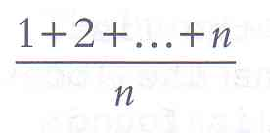
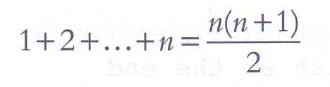
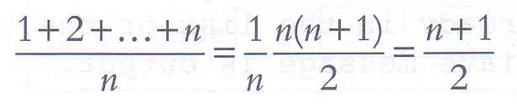
Sequential Search - Analysis
The following expression gives the average number of comparisons to find an item in a list size of n:
It is known that:
Therefore, the following expression gives the average number of comparisons made by the sequential search in the successful case:

Slide 45



Linear Search Tracing
Lets search for the number 3. We start at the beginning and check the first element in the array. Is it 3?
No, not it. Is it the next element?
Not there either. The next element?

Slide 46


Linear Search Tracing
Not there either. Next?
We found it!!! Now you understand the idea of linear searching;
we go through each element, in order, until we find the correct value or we don’t till the very end.

Slide 47
Linear Search Complexity
First of all, it is clear that the time required to execute the algorithm is proportional to the number of comparisons.
Also, assuming that each name in the file is equally likely to be picked, it is intuitively clear that the average number of comparisons for a file with n records is equal to n/2;
that is, the complexity of the linear search algorithm is given by O(n) for average case

Slide 48
Worst Case Efficiency for Linear Search
Get the value of target, n, and the list of n values 1
Set index to 1 1
Set found to false 1
Repeat steps 5-8 until found = true or index > n n
5 if the value of list_{index} = target then n
Output the index 0
Set found to true 0
8 else Increment the index by 1 n
9 if not found then 1
10 Print a message that target was not found 0
Stop 1
Total 3n+5

Slide 49
Analysis of Sequential Search
Time efficiency
Best-case : 1 comparison
target is found immediately
Worst-case: 3n + 5 comparisons
Target is not found
Average-case: 3n/2+4 comparisons
Target is found in the middle
Space efficiency
How much space is used in addition to the input?

Slide 50
Order of Magnitude
Worst-case of Linear search:
3n+5 comparisons
Are these constants accurate? Can we ignore them?
Simplification:
ignore the constants, look only at the order of magnitude
n, 0.5n, 2n, 4n, 3n+5, 2n+100, 0.1n+3 are all linear
we say that their order of magnitude is n
3n+5 is order of magnitude n: 3n+5 = Θ(n)
2n +100 is order of magnitude n: 2n+100=Θ(n)
0.1n+3 is order of magnitude n: 0.1n+3=Θ(n)
….

Slide 51
Linear Search
The Linear Search algorithm would be impossible in practice if we were searching through a list consisting of thousands of names, as in a telephone book.
However, if the names are sorted alphabetically, as in telephone books, then we can use an efficient algorithm called binary search.
We may have to use binary search.

Slide 52
Binary Search

Slide 53
The Scenario
We have a sorted array
We want to determine if a particular element is in the array
Once found, print or return (index, boolean, etc.)
If not found, indicate the element is not in the collection
7 12 42 59 71 86 104 212

Slide 54
A Better Search Algorithm
Of course we could use our simpler search and traverse the array
But we can use the fact that the array is sorted to our advantage
This will allow us to reduce the number of comparisons

Slide 55
Binary Search
Requires a sorted array or a binary search tree.
Cuts the “search space” in half each time.
Keeps cutting the search space in half until the target is found or has exhausted the all possible locations.

Slide 56
The Binary Search Algorithm
calculate middle position
if (first and last have “crossed”) then
“Item not found”
Else if (element at middle = to_find) then
“Item Found”
Else if to_find < element at middle then
Look to the left
else
Look to the right

Slide 57
Binary Search Program
int binarySearch (int list[], int size, int key) {
int first = 0, last , mid, position = -1;
last = size - 1
int found = 0;
while (!found && first <= last) {
middle = (first + last) / 2; /* Calculate mid point */
if (list[mid] == key) { /* If value is found at mid */
found = 1;
position = mid;
}
else if (list[mid] > key) /* If value is in lower half */
last = mid - 1;
else
first = mid + 1; /* If value is in upper half */
} // end while loop
return position;
} // end of function

Slide 58
Binary Search Demo
Maintain array of Items
Store in sorted order
Use binary search to find Item with key = 33
index
0
1
2
3
4
5
6
7
8
9
10
11
12
13
14
value
6
13
14
25
33
43
51
53
64
72
84
93
95
96
97

Slide 59
Maintain array of Items
Store in sorted order
Use binary search to find Item with key = 33
left
right
index
0
1
2
3
4
5
6
7
8
9
10
11
12
13
14
value
6
13
14
25
33
43
51
53
64
72
84
93
95
96
97
if Key v is in array, it is has index between left and right.

Slide 60
Maintain array of Items
Store in sorted order
Use binary search to find Item with key = 33
left
mid
right
index
0
1
2
3
4
5
6
7
8
9
10
11
12
13
14
value
6
13
14
25
33
43
51
53
64
72
84
93
95
96
97
Compute midpoint and check if matching Key is in that position.

Slide 61
Maintain array of Items
Store in sorted order
Use binary search to find Item with key = 33
first
mid
last
index
0
1
2
3
4
5
6
7
8
9
10
11
12
13
14
value
6
13
14
25
33
43
51
53
64
72
84
93
95
96
97
Since 33 < 53, can reduce search interval.

Slide 62
Maintain array of Items
Store in sorted order
Use binary search to find Item with key = 33
first
last
index
0
1
2
3
4
5
6
7
8
9
10
11
12
13
14
value
6
13
14
25
33
43
51
53
64
72
84
93
95
96
97
Since 33 < 53, can reduce search interval.

Slide 63
Maintain array of Items
Store in sorted order
Use binary search to find Item with key = 33
first
mid
last
index
0
1
2
3
4
5
6
7
8
9
10
11
12
13
14
value
6
13
14
25
33
43
51
53
64
72
84
93
95
96
97
Compute midpoint and check if matching Key is in that position.

Slide 64
Maintain array of Items
Store in sorted order
Use binary search to find Item with key = 33
first
mid
last
index
0
1
2
3
4
5
6
7
8
9
10
11
12
13
14
value
6
13
14
25
33
43
51
53
64
72
84
93
95
96
97
Since 33 > 25, can reduce search interval.

Slide 65
Maintain array of Items
Store in sorted order
Use binary search to find Item with key = 33
first
last
index
0
1
2
3
4
5
6
7
8
9
10
11
12
13
14
value
6
13
14
25
33
43
51
53
64
72
84
93
95
96
97
Since 33 > 25, can reduce search interval.

Slide 66
Maintain array of Items
Store in sorted order
Use binary search to find Item with key = 33
first
last
index
0
1
2
3
4
5
6
7
8
9
10
11
12
13
14
value
6
13
14
25
33
43
51
53
64
72
84
93
95
96
97
mid

Slide 67
Maintain array of Items
Store in sorted order
Use binary search to find Item with key = 33
first
index
0
1
2
3
4
5
6
7
8
9
10
11
12
13
14
value
6
13
14
25
33
43
51
53
64
72
84
93
95
96
97
last
Compute midpoint and check if matching Key is in that position.

Slide 68
Maintain array of Items
Store in sorted order
Use binary search to find Item with key = 33
first
index
0
1
2
3
4
5
6
7
8
9
10
11
12
13
14
value
6
13
14
25
33
43
51
53
64
72
84
93
95
96
97
last
Matching Key found. Return index 4.

Slide 69
How Fast is a Binary Search?
Worst case: 11 items in the list took 4 tries
How about the worst case for a list with 32 items ?
1st try - list has 16 items
2nd try - list has 8 items
3rd try - list has 4 items
4th try - list has 2 items
5th try - list has 1 item

Slide 70
How Fast is a Binary Search?
List has 250 items
1st try - 125 items
2nd try - 63 items
3rd try - 32 items
4th try - 16 items
5th try - 8 items
6th try - 4 items
7th try - 2 items
8th try - 1 item
List has 512 items
1st try - 256 items
2nd try - 128 items
3rd try - 64 items
4th try - 32 items
5th try - 16 items
6th try - 8 items
7th try - 4 items
8th try - 2 items
9th try - 1 item

Slide 71
A Very Fast Algorithm!
How long (worst case) will it take to find an item in a list 30,000 items long?
2¹⁰ = 1024 2¹³ = 8192
2¹¹ = 2048 2¹⁴ = 16384
2¹² = 4096 2¹⁵ = 32768
So, it will take only 15 tries!

Slide 72
Binary search reduces the work by half at each comparison
If array is not sorted ➔ Linear Search
Best Case O(1)
Worst Case O(N)
If array is sorted ➔ Binary search
Best Case O(1)
Worst Case O(Log₂N)

Slide 73
Comparing Search Algorithms

Slide 74
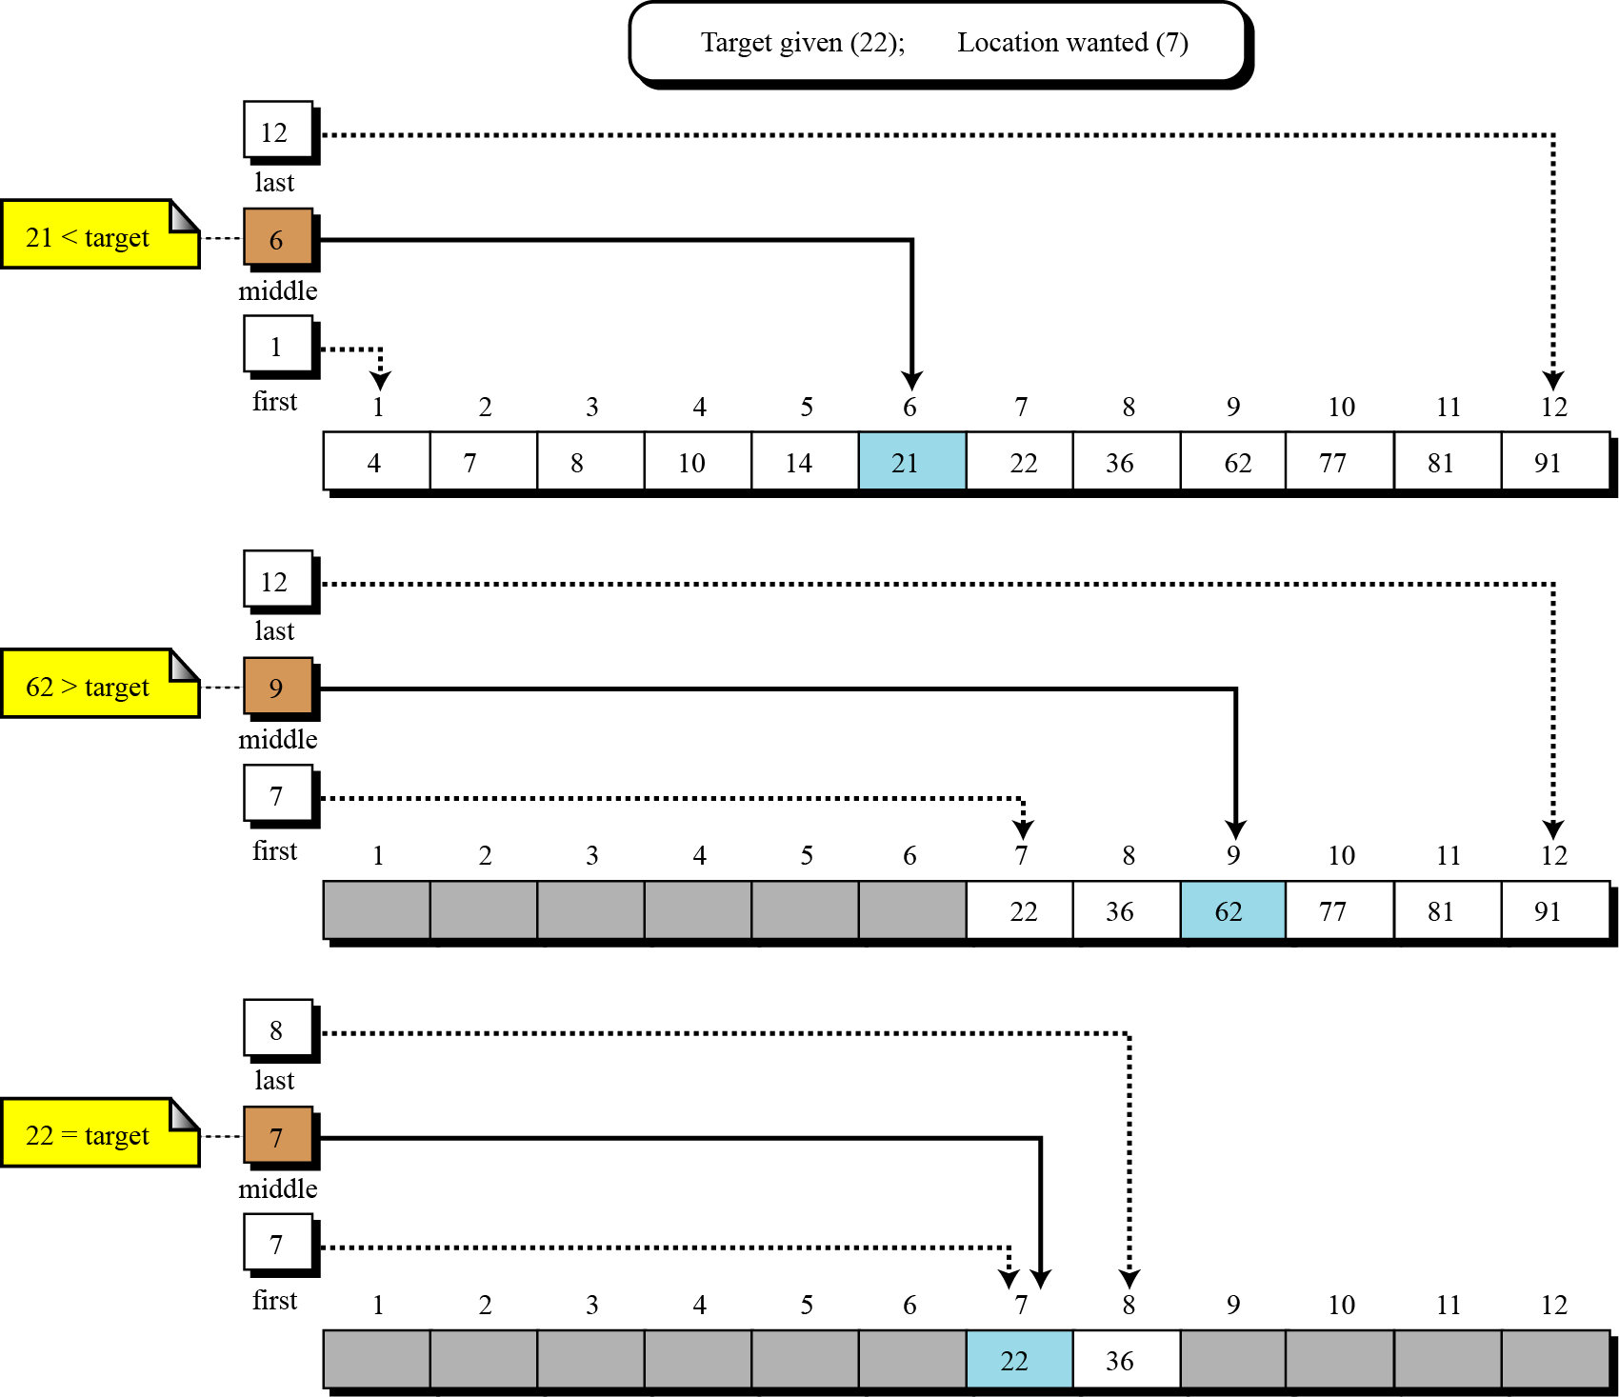
Binary Search

Slide 75
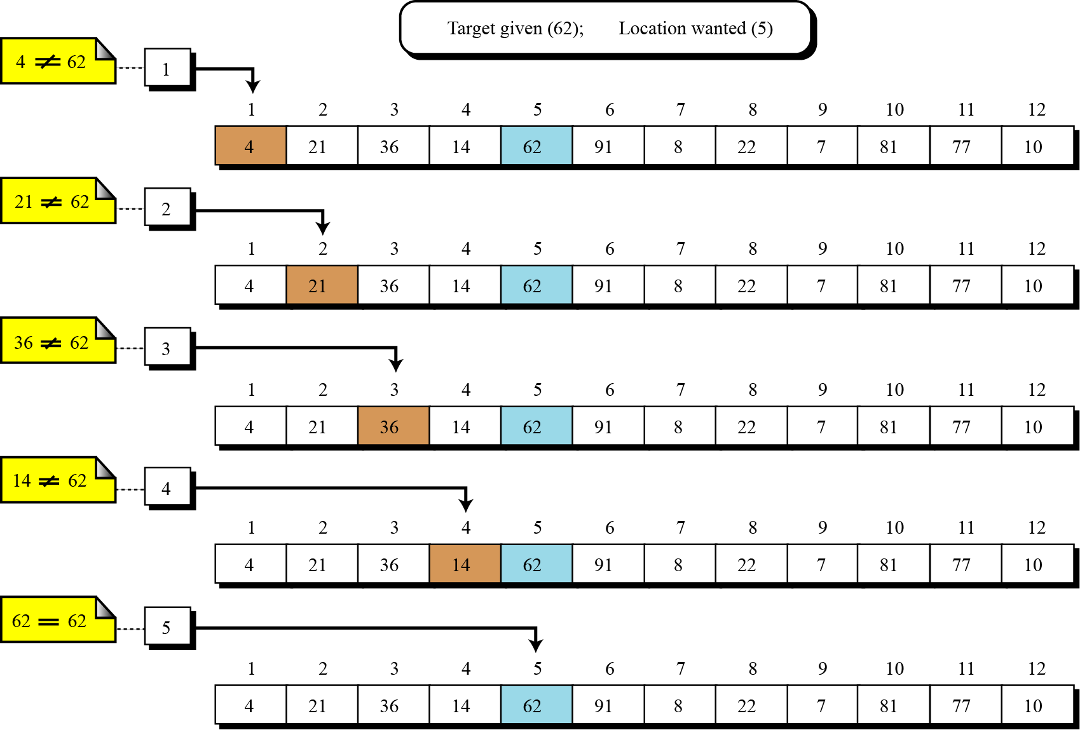
Linear (Sequential) Search

Slide 76
Comparing Search Algorithms
We know
sequential search is O(n) worst-case
binary search is O(log₂ n) worst-case
Which is better?
Given n = 1,000,000 items
O(n) = O(1,000,000) /* sequential */
O(log₂ n) = O(19) /* binary */
Clearly binary search is better in worst-case for large values of n, but there is always trade-offs that must be considered
Binary search requires the array to be sorted
If the item to be found is near the extremes of the array, sequential may be faster

Slide 77
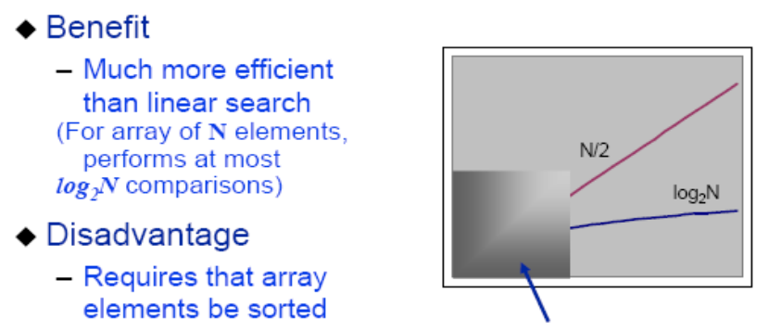
Binary Search Tradeoffs

Slide 78
Comparing Sequential and Binary
The sequential search starts at the first element in the list and continues down the list until either the item is found or the entire list has been searched. If the wanted item is found, its index is returned. So it is slow.
Sequential search is not efficient because on the average it needs to search half a list to find an item.
A Binary search is much faster than a sequential search.
Binary search works only on an ordered list.
Binary search is efficient as it disregards lower half after a comparison.

Slide 79
Summary
Overview of Search Algorithms
Algorithm Analysis
Time and Space Complexity
Big O Notation
Introduction of Linear Searching
Introduction to Binary Search,
Comparison of Linear and Binary Search

Slide 80
References
https://www.geeksforgeeks.org/searching-algorithms/
https://www.studytonight.com/data-structures/search-algorithms
https://www.tutorialspoint.com/data_structures_algorithms/linear_search_algorithm.htm

